Slide 1
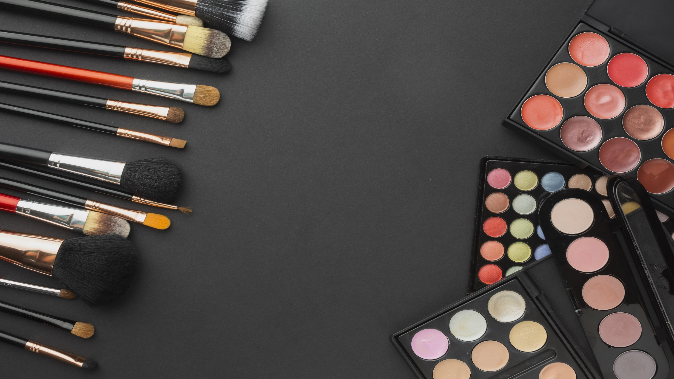
Cosmetic Harmfulness Checker
R180446- B.Rakesh

Slide 2
Outline
Introduction
Abstract
Industry challenge
Understanding the Cosmetic Harmfulness Checker
User interface
Features and Functionality
Ensuring Accuracy and Reliability
Future Developments and Conclusion

Slide 3

Introduction
The "Cosmetic Harmfulness Checker" is a user-friendly application using computer vision and Chatbot technology to empower consumers in evaluating the safety of cosmetic products. With features like automatic label recognition through a camera interface and Chatbot-powered assessments of ingredients, it simplifies decision-making. This project combines cutting-edge tech to promote consumer awareness and health consciousness in the cosmetics industry.

Slide 4

Abstract
A Cosmetic Harmfulness Checker is a tool designed to help consumers make informed decisions about the safety and potential risks of beauty products. In an era where cosmetics are widely used, ensuring the safety of these products is crucial for consumer health.

Slide 5
Industry Challenge
Diverse Ingredients: "A multitude of cosmetic products flood the market, each containing a unique combination of ingredients."
Lack of Transparency: "Consumers often face challenges in understanding the composition of these products and the potential risks associated with specific ingredients."
Health Concerns: "The need for consumer awareness is heightened as exposure to harmful cosmetic components can lead to adverse health effects."

Slide 6
Importance of Checking Cosmetic Harmfulness
Consumer Safety: Many cosmetic products contain chemicals that can have short-term or long-term health effects. Consumers have the right to know what they are applying to their skin.
Legal Regulations: The beauty industry is subject to regulations, and using harmful ingredients can lead to legal consequences for manufacturers.
Long-term Health Impact: Continuous exposure to certain chemicals can have cumulative effects on health. The harm may not be immediately apparent.

Slide 7
User Interface
Tkinter GUI: "Developed using Tkinter, the interface offers a visually appealing and user-friendly platform."
Manual Input: "Allows users to manually input cosmetic names for analysis."
Automated Detection: "Enables users to effortlessly utilize the camera interface for automated detection of cosmetic product labels."

Slide 8
Features and Functionality
Real-Time Detection: Seamlessly identifies cosmetic product labels, simplifying the user experience."
"Chatbot-Powered Insights: Leverages advanced NLP for comprehensive assessments of ingredient safety."
"User-Friendly Interface: Ensures accessibility and convenience for users, whether inputting names manually or using the camera."
"Promoting Transparency: Provides users with transparent information about cosmetic ingredients for informed decision-making."
"Educational Value: Acts as an educational tool, empowering users with knowledge about potential harmful ingredients."
"Scalability and Future-Ready: Designed for ongoing improvement and adaptability to emerging technologies."

Slide 9
Project Objectives
Clearly list the primary objectives of the Cosmetic Harmfulness Checker project Integration of computer vision for object detection
Utilization of NLP through Chatbot for ingredient analysis
Developing a user-friendly interface for easy interaction

Slide 10
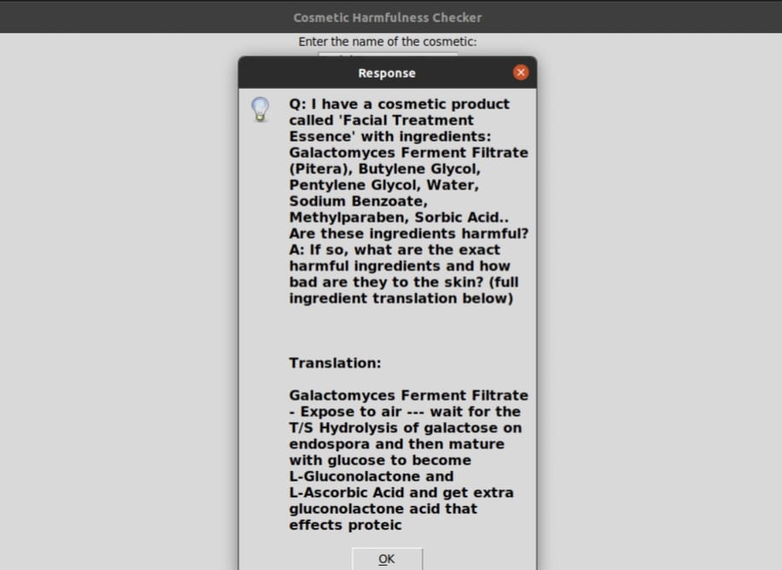
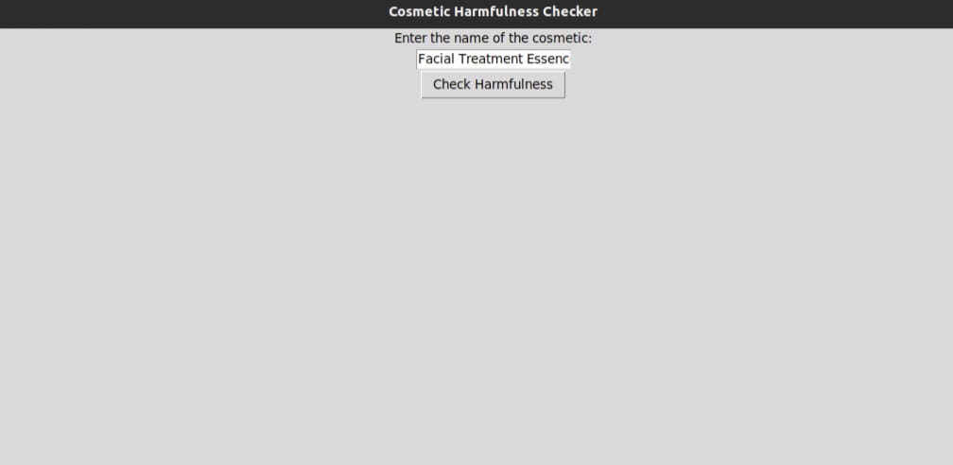
Working
Input
Output

Slide 11
Scope and Future Enhancements
Object Detection and Recognition:
"Scope includes implementing advanced object detection algorithms for improved accuracy."
"Exploring additional AI models for nuanced label recognition and text extraction."
Dataset Integration:
- "Potential to expand the dataset for a more comprehensive coverage of cosmetic products."
"Incorporating user reviews to enrich the dataset and enhance analysis."
User Interface Development:
- "Refining the OCR (Optical Character Recognition) for more accurate text extraction."
"Exploring user customization options for a personalized experience.“
To add object detection functionality to detect cosmetic products through computer vision.
live feed through camera

Slide 12
Conclusion
At its core, the "Cosmetic Harmfulness Checker" operates through two key components. The first, "Object Detection and Recognition," utilizes advanced computer vision techniques. Users can effortlessly point their cameras at cosmetic products, enabling the application to automatically capture and identify product names. The second, "Chatbot-Powered Assessment," further enhances the user experience by querying OpenAI's GPT-3 for insights into the safety of detected cosmetic ingredients.

Slide 13
Thank you

